Slide 1
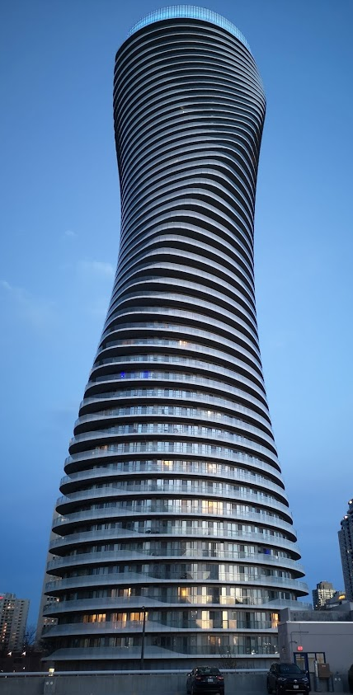
Teranet dataset
EDA results

Slide 2
Section 1:
Distributions

Slide 3
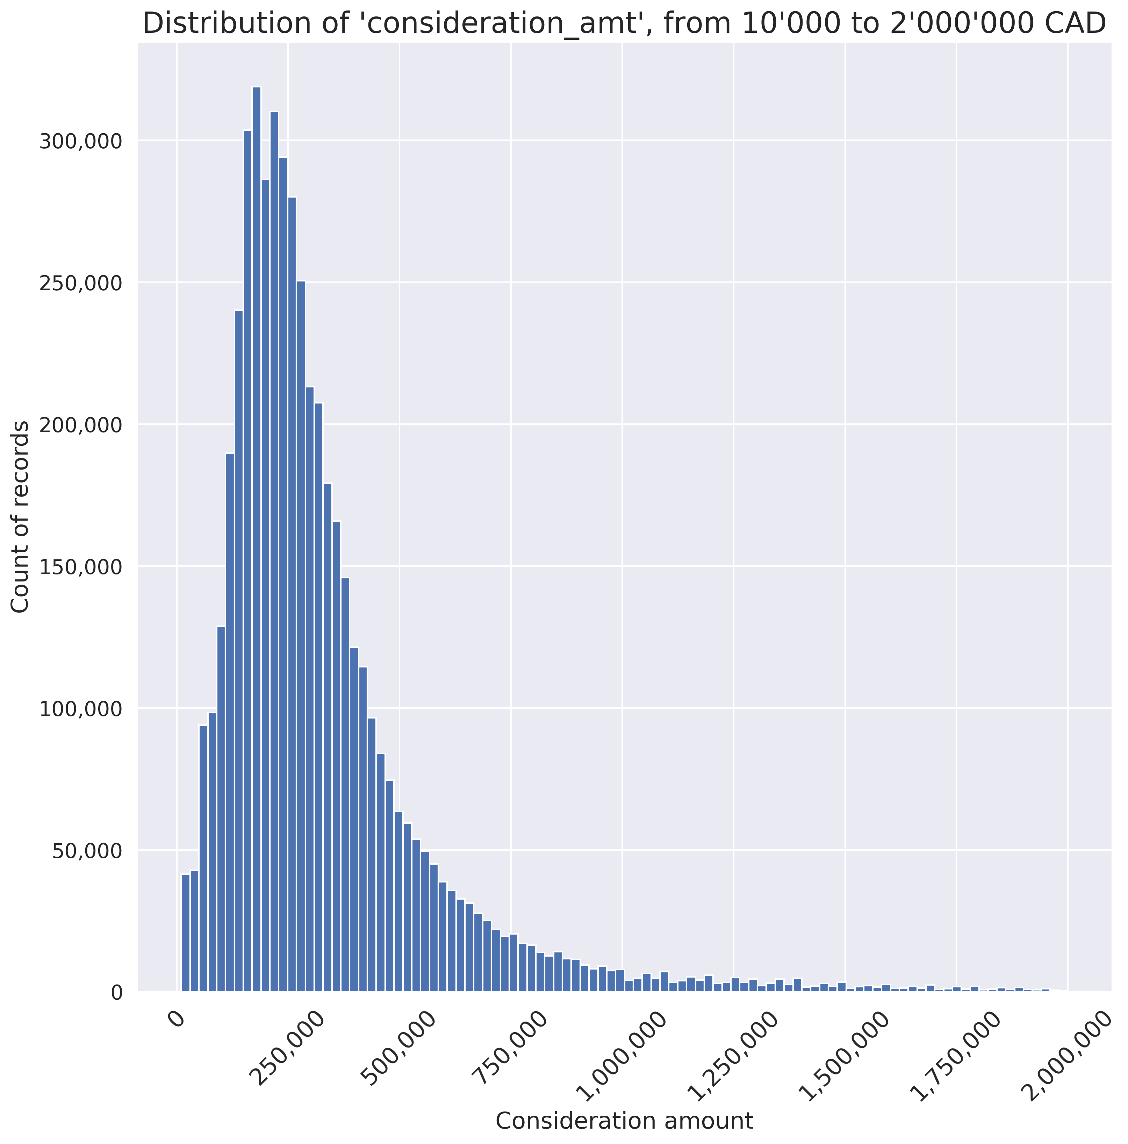
1.1: Distribution of consideration amount
Records with consideration amount < 10’000 CAD have been removed from the dataset in Step 2.4
Records with consideration amount above 2’000’000 CAD remain in the dataset, but have been excluded from this plot

Slide 4
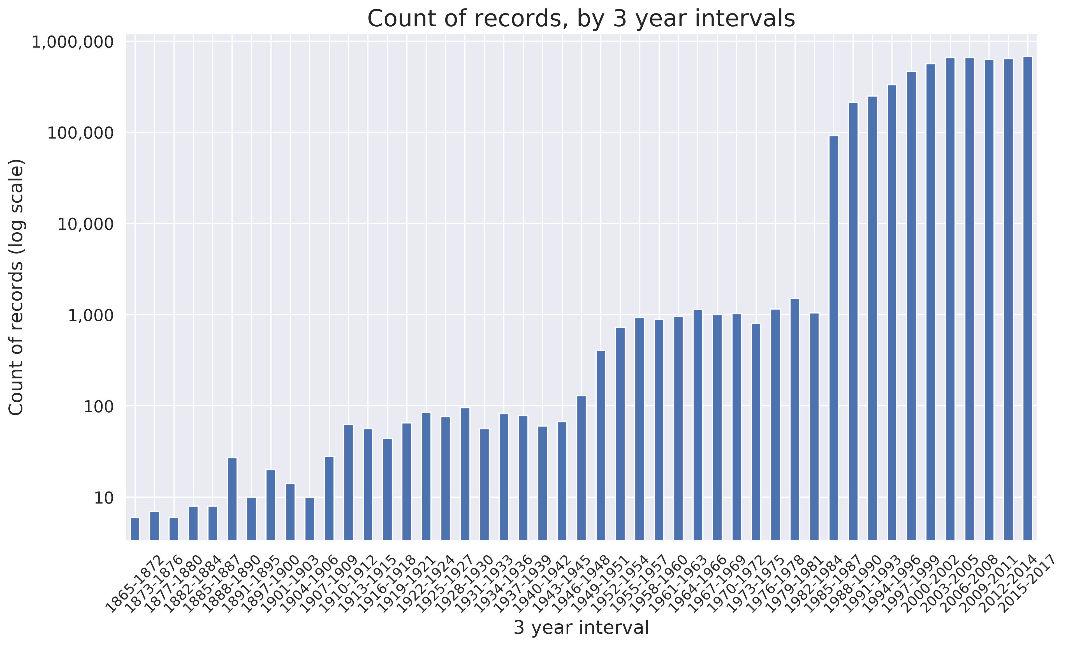
1.2: Distribution of count of records
Dramatic change in the count of records from 1984 to 1985

Slide 5
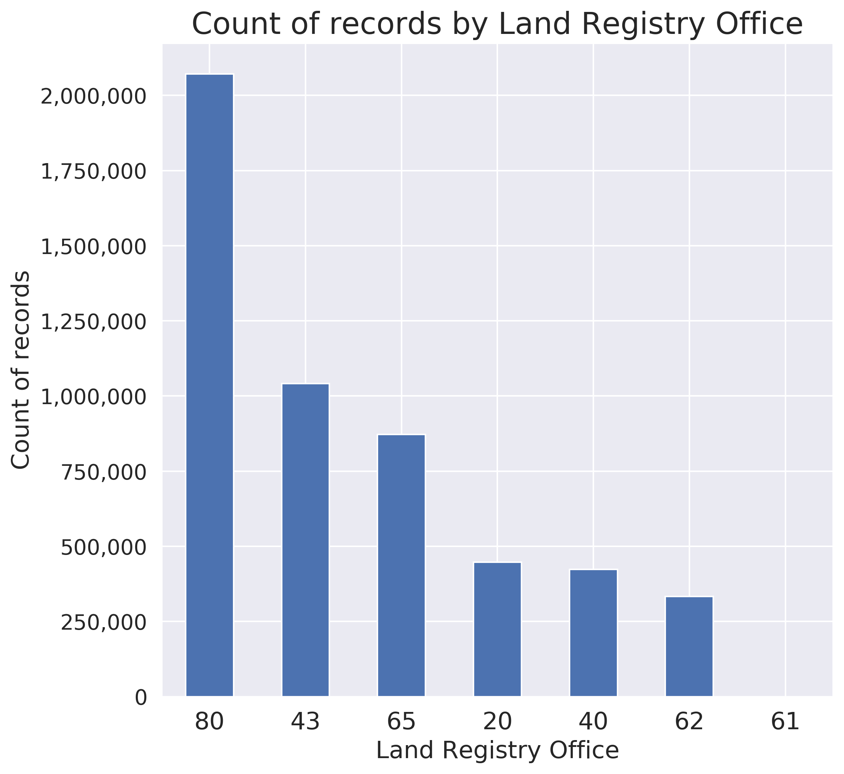
1.2: Distribution of count of records by LRO

Slide 6
Section 1:
Large counts of records
by street name

Slide 7
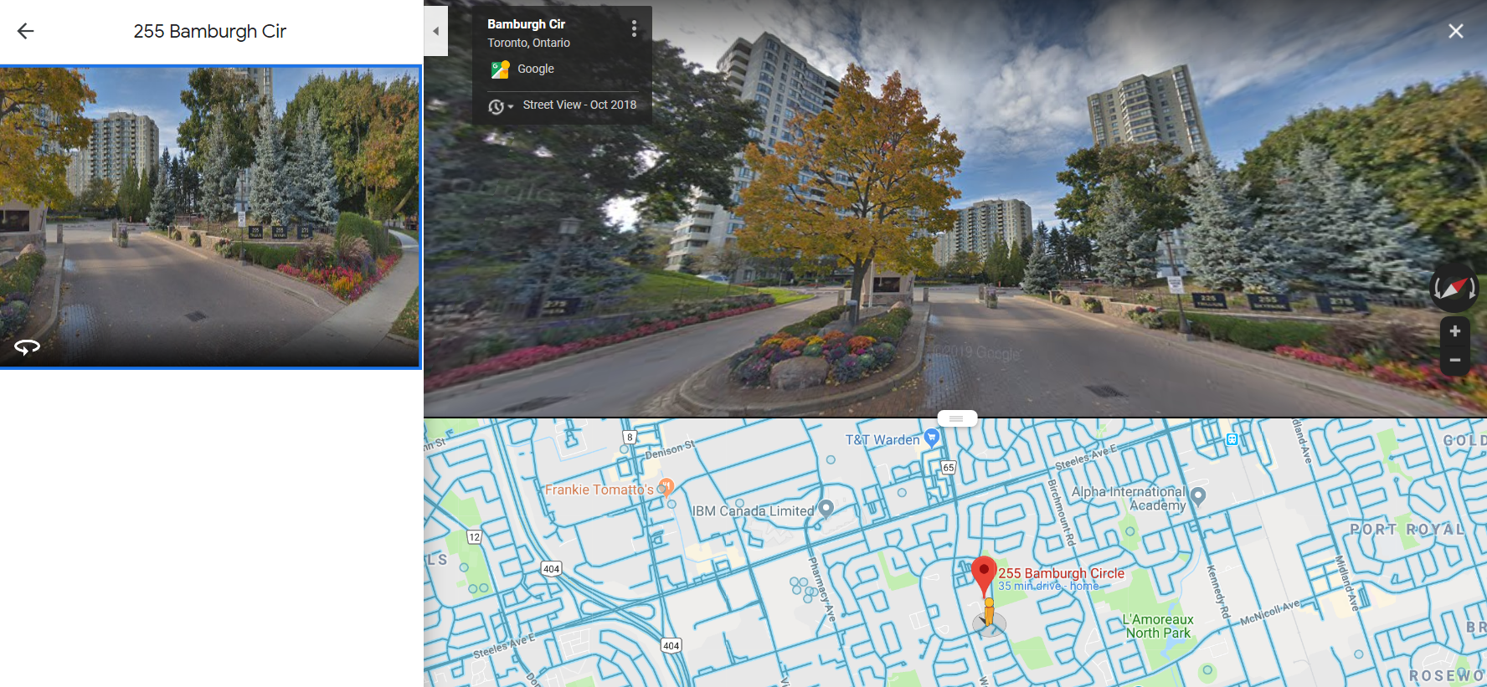
1.1: Bamburgh Cir, Scarborough

Slide 8
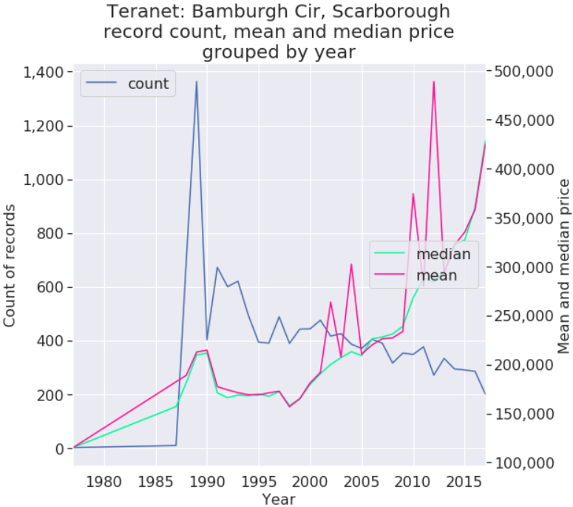
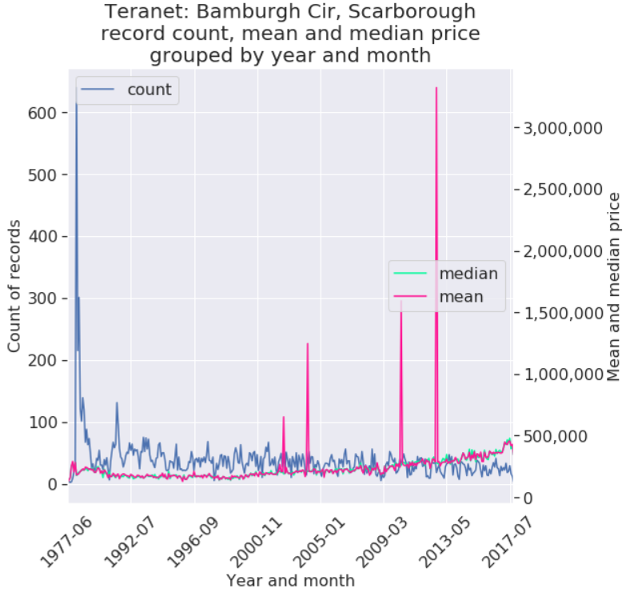
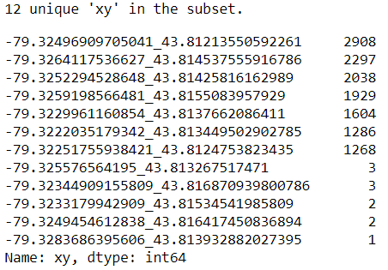
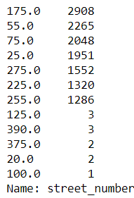
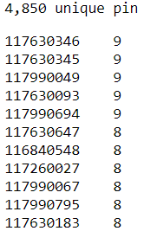
1.1: Bamburgh circle, Scarborough
Teranet record count
By street address:
By xy:
By pin:

Slide 9
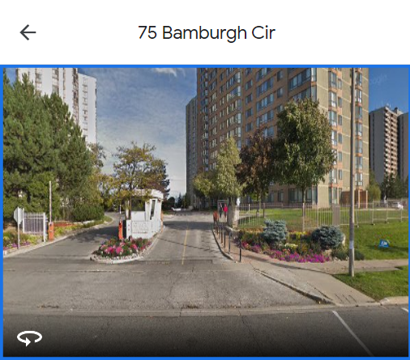
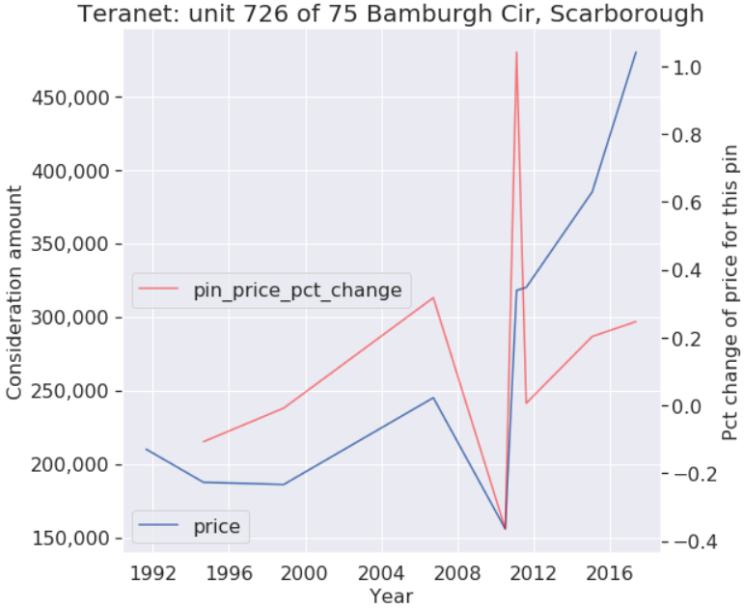
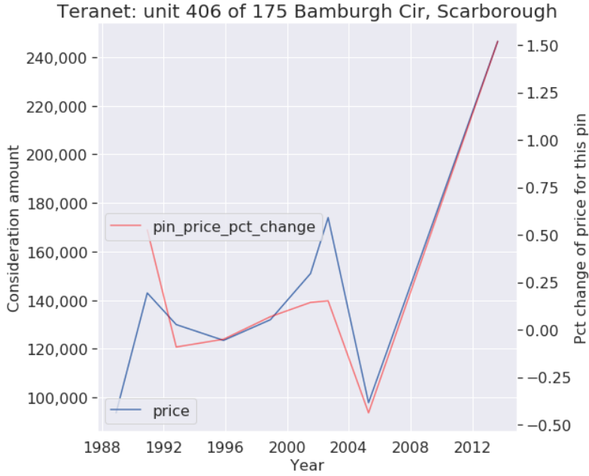
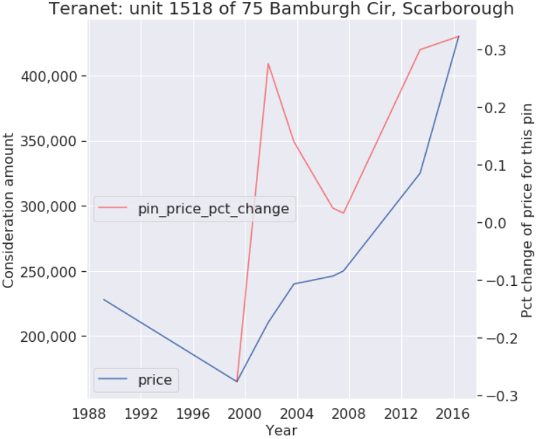
75 Bamburgh Cir, Scarborough individual unit sales

Slide 10
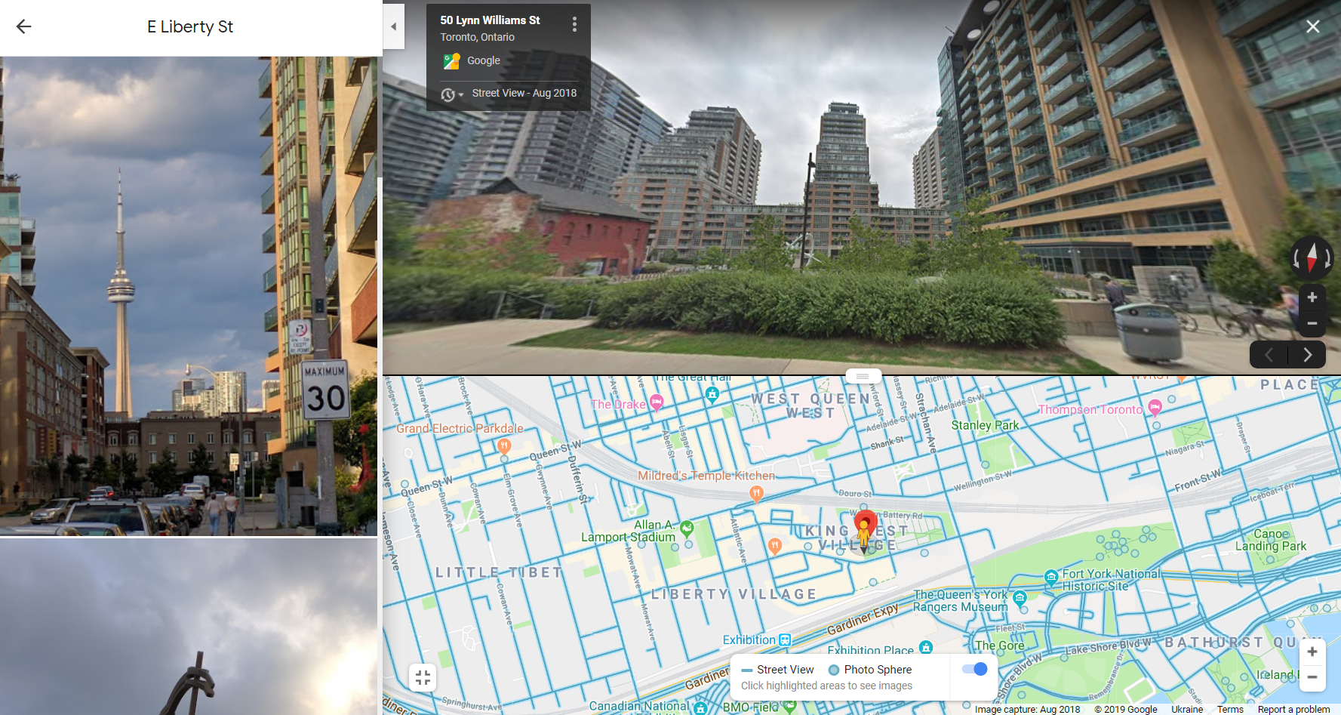
1.2: East Liberty St, Toronto

Slide 11
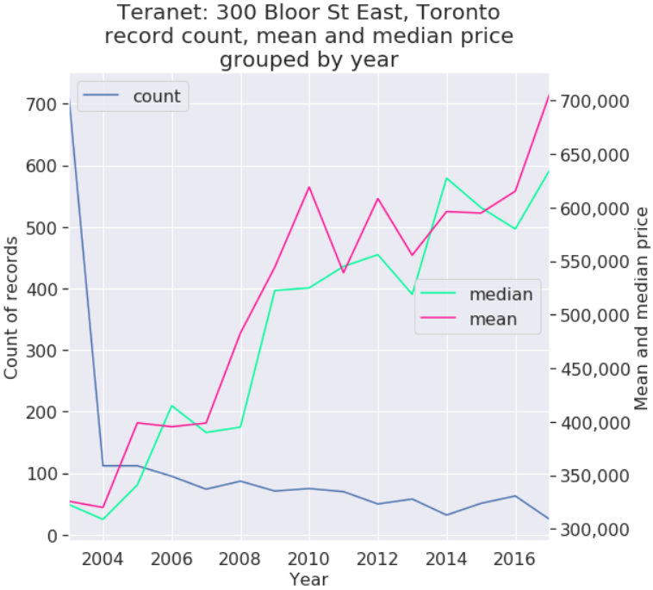
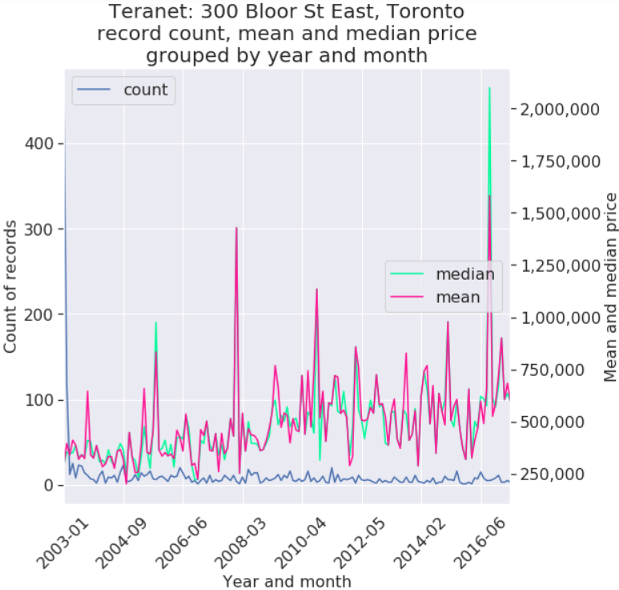
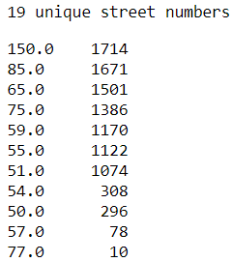
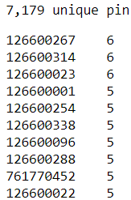
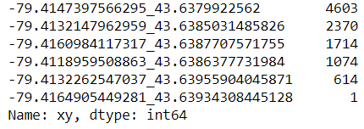
1.2: East Liberty St, Toronto
Teranet record count
By xy:
By street address:
By pin:

Slide 12
Section 2:
Large counts of records
by individual address

Slide 13
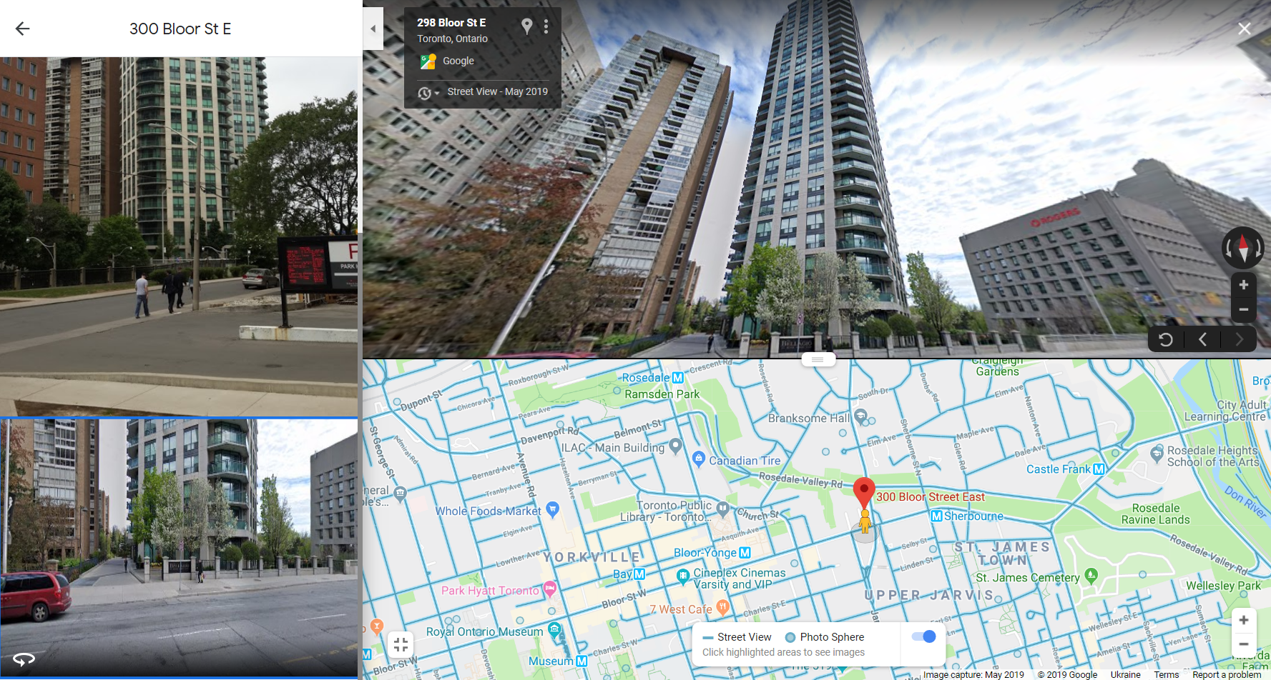
2.1: 300 Bloor St East, Toronto

Slide 14
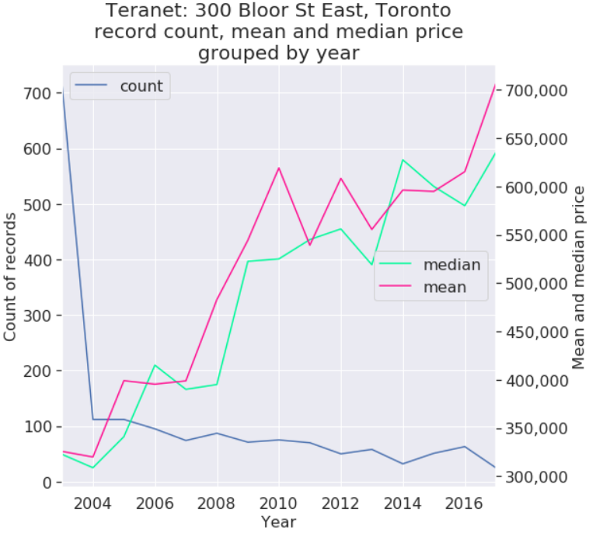
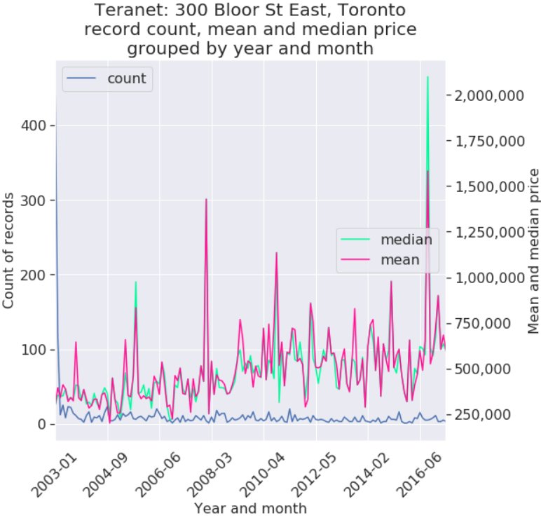
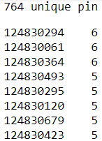
2.1: 300 Bloor St East, Toronto
Teranet record count
By pin:
By street address:
By xy:

